Slide 1
The Daniel Boone Green Team Presents
Anaerobic Digesters

Slide 2
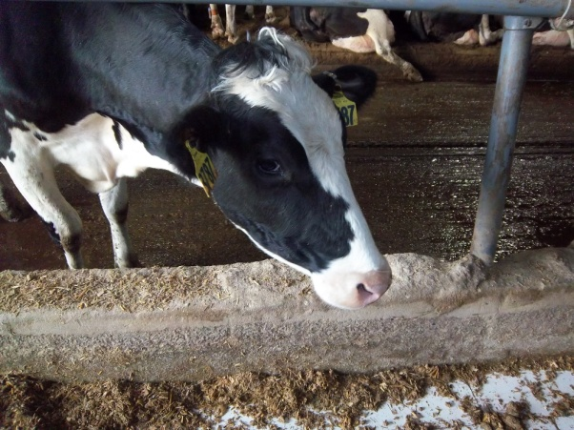
PA Outlook
PA is #12 in total animal waste: 22 million tons
Cattle waste is 82%
30 Gal of Manure per cow per day
=
Two100-Watt Bulbs for 24 hours
Notes:
a

Slide 3
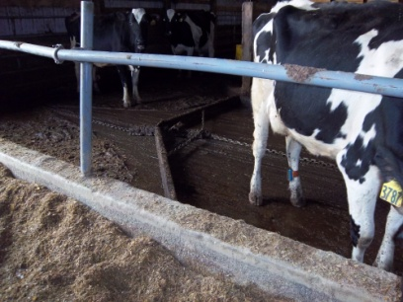
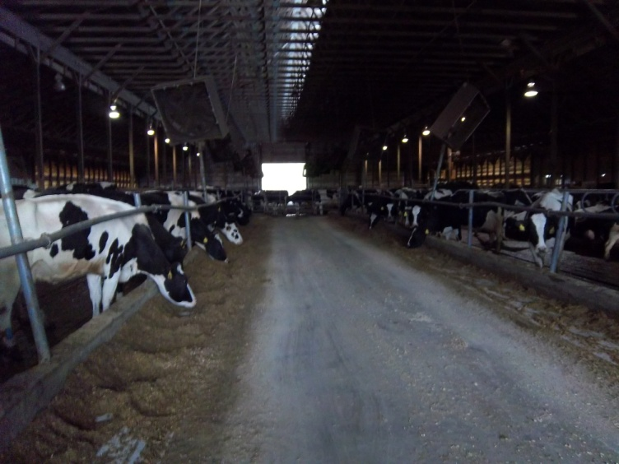
Field Management
Reduced Runoff
Free Stall Barn
Manure Scraper
Stream Health
Phosphorus
Less Tractor or Trucks
Less Erosion, Sedimentation
Compaction
Notes:
a

Slide 4
Green House Gases
What are they?
Gases that contribute to global warming
Usually caused by the burning of fossil fuels
Are emitted into the atmosphere when regular decomposition occurs
Examples
Sulfur
Coal
Notes:
r

Slide 5
Reduction of Green House Gases
Methane (CH₄)
Harnessed from the digester
Less methane is released into the atmosphere (51,000 metric tons was prevented by 162 digesters in 2010)
Carbon Dioxide (CO₂)
Fossil Fuel Burning vs Methane Burning
Would have been released into atmosphere (246,000 metric tons was prevented by162 digesters in 2010)
Notes:
r

Slide 6
This Means
Removing
235,500
Cars off the road
=
About
1,454
Cars Per Digester
Notes:
r

Slide 7
The Science
Manure contains Bacteria and Archaea that undergo a anaerobic process, Methanogenesis, creating Biogas at
70% is Methane
30% is Carbon Dioxide
<1% is Hydrogen Sulfide
80 ft³ of biogas per cow per day when utilizing all manure*
When converting to electrical energy, this creates about .278 kW· h per cow.
*Courtesy, Mr. Stanley Weeks
Notes:
q

Slide 8
What is a Digester?
An anaerobic digester recreates the oxygen-less environments of a stomach, and allows organisms to digest the manure and biomass to create biogas
The system is fed daily with organic waste to continue production
Notes:
q

Slide 9
Our Prototype
LET’S
DO
THIS.
LET’S
LET’S
DO
DO
THIS.
THIS.
Notes:
Explain this slide during presentations: all three

Slide 10
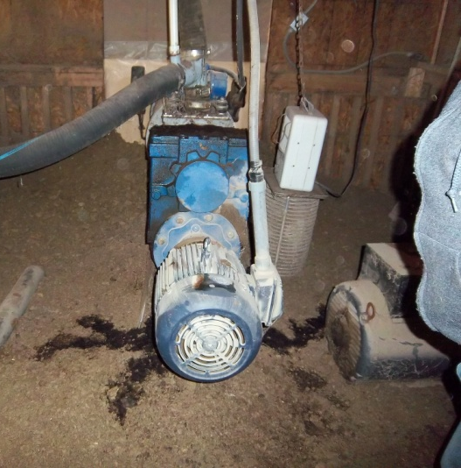
Solid Separator Example
Filters
Powered by screw press
Augers out Liquid
Liquid Digestate
Faster absorption into plants, because of nitrifying bacteria (Bio Fertilizer)
Irrigation Pump, slower but more beneficial
Fibrous Digestate
Bedding (Straw cost avoided, savings of $37,000)
Phosphorus Application Reduced
Notes:
a

Slide 11
Advantages
Environmentally Friendly
Reduces the need to spread/transport manure
Renewable Energy Credits/Carbon Credits
Heat from the generator can be used as heat source
Digestate can be used for bedding & fertilizer
Can become Energy Independent
Odor Control
Energy for farm and to sell back
Notes:
q

Slide 12
Disadvantages
Hydrogen Sulfide Smell
Requires Initial Investment
Routine Maintenance
Notes:
q

Slide 13
Timeframe
*Courtesy RCM Digesters
Notes:
r

Slide 14
Who Already Has One?
Approximately 200-250 (199 documented at dairy farms) commercial digesters in operation
Digesters feasible at around 8,000 farms
Only recently with the advent of metering has it been a profitable endeavor
Mor Dale Farms– Mr. Ralph Moyer
500 cows (heifers and calves) producing 15,000 gallons of manure daily (running for 6 years)
Powering entire farm and 30-50 homes in area
Wanner Pride ‘n’ Joy Farm – Mr. Alfred Wanner
700 cows
Offsets electricity cost by $50,000 a year
Notes:
r

Slide 15
Who’s Supporting These Projects?
Environmental Protection Agency (EPA)
Government agency for the reduction of pollution to the environment with a focus on conservation projects
AgSTAR
Outreach program focused on reducing methane emissions through the promotion of digester systems
Chesapeake Bay Foundation
Leader and director of restoration projects in Chesapeake Bay Area (includes Maryland, Pennsylvania, Virginia, and Washington, D.C.)
Natural Resources Conservation Service (NRCS)
Provides financial and technical assistance to farmers and ranchers for conservation projects
Notes:
a

Slide 16
Frequently Asked Questions
What are the obstacles to widespread use of digesters?
Number of animals and type of manure collection system
Initial capital cost
How do I know if a biogas digester is feasible for my farm?
Manure Handling
Systems require manure to be handled as a liquid, slurry, or semisolid (w/ little to no bedding)
Grazing or Stalling
Stalling allows easy collection of manure rather than if cows were grazing
Notes:
A
Intended Gas Use
Can be used in boilers, in combustion engines, in electrical generators, as vehicle fuel, or injected into the natural gas pipeline

Slide 17
Frequently Asked Questions
How are biogas digesters usually funded?
Various grants and loans
Are there other financial gains, other than the energy produced?
Carbon credits based on the amount of methane reduced through the digester’s installation
Bedding
Renewable Energy Credits
Erosion/Soil Compaction Reduction
Notes:
A
Amount of methane originally emitted is called ‘baseline’ emissions
Different baseline emissions contribute to different emission reductions between similar farms

Slide 18
Chesapeake Bay Foundation Grant Programs
REAP (Restoration Enhancement and Protection)
Provides tax-credits to farmers for implementing environmentally sound farming practices
Tries to cut down on manure spillage in the environment and pollution in the water
Offers to pay for 50%-75% of these farm practices
Application online through CBF website
Buffer Bonus
Help funds conservation work to make on-farm improvements affecting air quality
Provides Conservation and Nutrient Management Plan to assist with applying for federal funding
Notes:
q

Slide 19
NRCS (National Resources Conservation Service) Federal Farm Bill-Financial Assistance
Environmental Quality Incentives Program
Will provide financial and technical assistance to be paid after carrying out a designed action plan
Contracts can last up to 10 years, after which the system should have paid for itself
Conservation Stewardship Program
Goal: improve water, habitat and air quality and increase clean energy
Agricultural Management Assistance Program
Promotes conservation as a way to reduce risks to natural resources
Notes:
r

Slide 20
Farm Bill Financial Assistance: Conservation Stewardship Program
Goal: improve water, habitat and air quality and increase clean energy
5 year contracts consisting of two types of payments
Annually: for conservation activities and maintaining those practices
Supplemental: adopting resource-conservation crop rotation
Notes:
r

Slide 21
Case Studies
Case Studies
Notes:
q

Slide 22
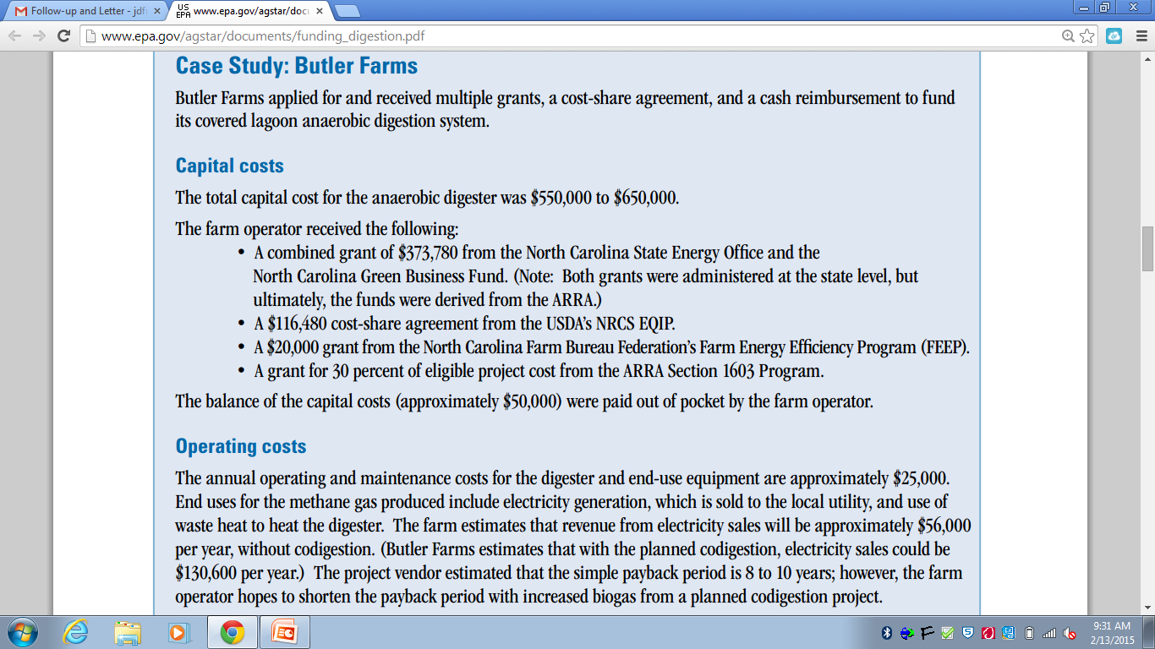
Notes:
q

Slide 23
Links and References
Solutions 4 Energy Article on Digesters
EPA’s AgSTAR 2010 article on the statistics of Digesters
National Resource Defense Council’s Article on Biomass Energy
RCM’s Article on different Digester designs
Notes:
Names as Hyper Links

Slide 24
Who Should I Contact to Get Started?
BioGreen Engineering
Consultation firm specializing in technical and regulatory assistance
Services offered include:
Analyze feasibility of project
Walk through registration, validation, and certification processes
Maximize client revenues without compromising greenhouse emission reduction credits
Helped assess, design, construct, maintain, and monitor over 700 digesters worldwide
Devlar Energy Marketing
Consultation firm for buying and selling of natural gas
Specializing in finding best way to bring gas to market for highest price
Helps handle contract negotiations, scheduling, invoicing, and imbalance management
RCM Digesters
Consolation firm focused on finances and construction of digester
Assess feasibility of digester and best type to use
Determine costs and write grants
Construct digester and test efficiency
AgriWaste
Consultation firm focused on digester designs and verification of carbon credits
Positive Energy Alternative, LLC
Consultation firm specializing in overall supervision of digester construction
Determines biogas supply, obtains site and environmental permits, gains regulatory approval, supervises construction, etc.
Climate Action Reserve
Consultation firm specializing in finance
Sets standards for and issues carbon credits– tracks transaction of credits over time

Slide 25
Local Farmers to Contact
Mr. Alfred Wanner
(717)278-1560
5800 Wanner Road, Narvon, PA 17557
Wanner’s Pride-n-Joy
Mr. Ralph Moyer
(717)933-5550
91 Frystown Road, Myerstown, PA 17067
Mor-Dale Farms

Slide 27
Biogas Map – Contacts
http://www.nrdc.org/energy/renewables/map_biomass.asp#map

Slide 28
Qualifications for EQIP from NRCS
Must control or own non-industrial private forestland, cropland, rangeland, or pastureland
Comply with Adjusted Gross Income provisions:
AGI limit is $900,000
Agree with highly erodible land/wetland conservation requirements:
Cannot change a wetland for agricultural production
Develop a plan of operation with the EQIP

Slide 29
Eligibility for Increased/Advanced Payment through NRCS Farm Bill
Up to 50% of the total payment up front
Socially disadvantaged farmers (racial discrimination)
Farmers with limited resources
Indian Tribes
War veterans

Slide 30
NRCS Farm Bill: Easements (for the environment)
Agricultural Conservation Easement Program
Goal: “restore, protect, and enhance wetlands,” protect America’s food supply
Financial and technical assistance to purchase land easements
Healthy Forests Reserve Program
Promotes carbon sequestration to protect forestland and ecosystems from pollution
Land must be privately owned or owned by Indian Tribes
10 year restoration agreements or 30 year permanent easement contract
All application information can be found on the Farm Bill subpage of the NRCS website

Slide 33
Source: EPA office of Air and Radiation

Slide 34
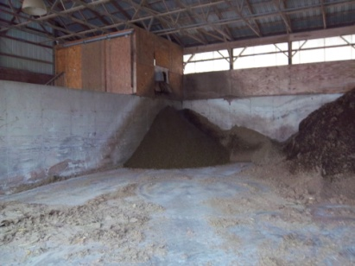
Solid Separator Example
2 Components
Inner
$3,000 replaced 6 months to 1 year
Outer
Replaced 1-2 years
Notes:
a

